Slide 1
The particle swarm optimization algorithm: convergence analysis and parameter selection
I.C. Trelea
Information Processing Letters 85 (2003) 317-325
Presenter: Tsung-Jung Tsai (蔡宗容)
Date: June 20, 2007
Notes:
● 粒子群最佳化演算法是Kennedy和Eberhart於1995年時提出，在研究PSO的過程中，有各種不同版本出現 [4-9]，也有收斂及最佳參數選定的探討文獻 [10-11]。PSO的概念源自群體行為理論，啟發自觀察鳥群或魚群行動時，能透過個體間特別的訊息傳遞方式，使整個團體朝同一方向、目標而去，是模仿此類生物行為反應來尋求完成群體最大利益的方法。PSO的基本演算模式如下：首以均勻分佈(uniform distribution)隨機產生初始粒子群，每一個粒子都是一個求解問題的侯選解，粒子群會參考個體的最佳經驗，以及群體的最佳經驗，選擇修正的方式，經過不斷的修正之後，粒子群會漸漸接近最佳解。
Reference: http://www.im.ncnu.edu.tw/new/html/now_info/doc/doc/First_FanBen.doc
● 粒子群優法(PSO)是一種模擬社會群體活動行為之智慧演算法，學者Eberhart和Kennedy藉由觀察鳥群飛行與魚群在水中移動的運動規律，在1995年發表關於鳥、魚群覓食行為的粒子群優演算方法。
在粒子群最佳化(optimization)方法中，每一個個體稱為粒子，且每個粒子有各自經驗，經由經驗交換，使得每個粒子能往距離食物點較近的路徑飛去。
Reference: http://210.71.15.19/download2/jjyan/951-Seminar%20¤W½Ò¸ê®Æ/®Ñ³ø°Q½×¸ê®Æ/±iÀ¹©ú_À³¥Î²É¤l¸sÀuªk©óFIRÂø°T.ppt

Slide 2
Abstract
The particle swarm optimization algorithm is analyzed using standard results from the dynamic system theory. Graphical parameter selection guidelines are derived. The exploration-exploitation(探測與開發) tradeoff is discussed and illustrated. Examples of performance on benchmark functions superior to previously published
results are given.

Slide 3

The particle swarm optimization (PSO)
developed by Kennedy and Eberhart in 1995.
a parallel evolutionary computation technique
based on the social behavior metaphor.
Notes:
粒子群優化算法(PSO)是一種進化計算技術(evolutionary computation)，由Eberhart博士和kennedy博士發明。源於對鳥群捕食的行為研究PSO同遺傳算法類似，是一種基於疊代的優化工具。系統初始化為一組隨機解，通過疊代搜尋最優值。

Slide 4
PSO algorithm
For each particle
Initialize particle
END
Do
For each particle
Calculate fitness value
If the fitness value is better than the best fitness value (pBest) in history
set current value as the new pBest
End
Choose the particle with the best fitness value of all the particles as the gBest
For each particle
Calculate particle velocity according equation
Update particle position according equation
End
While maximum iterations or minimum error criteria is not attained

Slide 5
Algorithm performance
Some tuning parameters that greatly influence the algorithm performance.
The performance often state as the exploration–exploitation tradeoff.

Slide 6
Exploration–exploitation(探測與開發)
Exploration is the ability to test various regions in the problem space in order to locate a good optimum, hopefully the global one.
Exploitation is the ability to concentrate the search around a promising candidate solution in order to locate the optimum precisely.
Notes:
hopefully ad. (副詞 adverb)
懷希望地;抱希望地
He smiled hopefully in their direction. 他朝著他們的方向滿懷希望地微笑著。
(多用來修飾全句)但願
Hopefully we will be there by six. 但願我們能在六點之前趕到那兒
promising a. (形容詞 adjective)
有希望的,有前途的,大有可為的

Slide 7
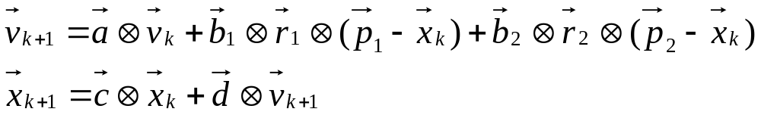

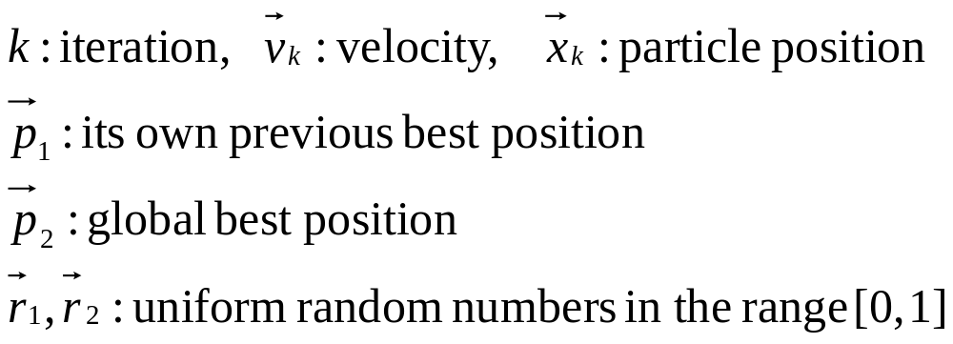
Standard PSO algorithm
The symbol denotes element-by-element vector multiplication.

Slide 8
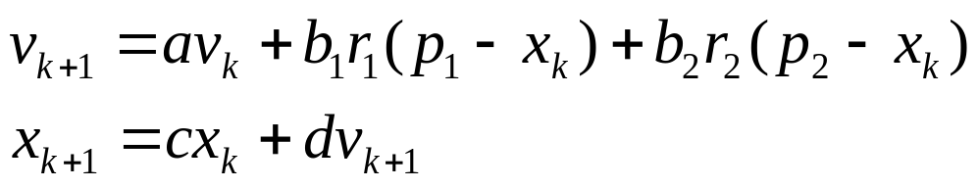
One-dimensional algorithm
Each dimension is updated independently from eachs.

Slide 9
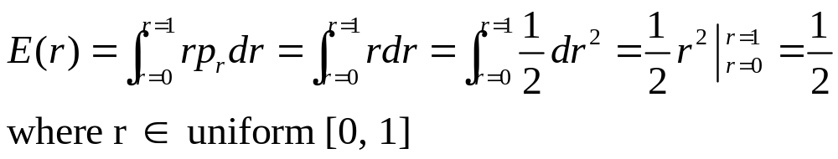
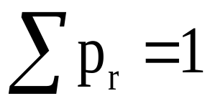
Deterministic algorithm
E: expectation
Pr
1
r
0
1

Slide 10
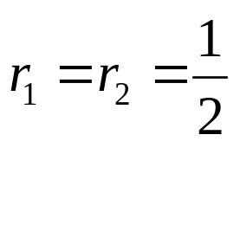
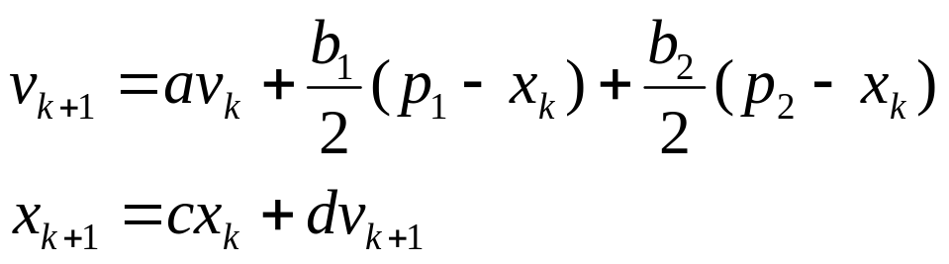
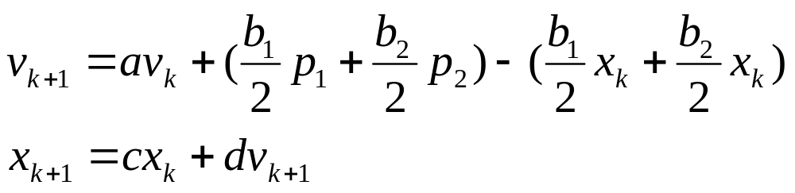
Deterministic algorithm (Cont.)

Slide 11
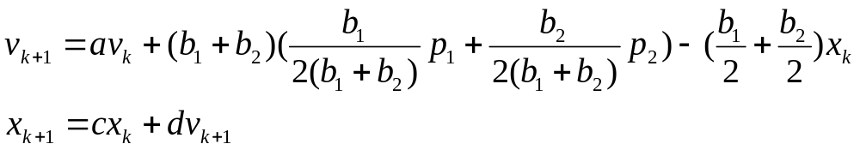
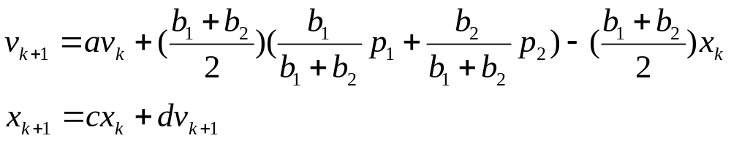
Deterministic algorithm (Cont.)

Slide 12
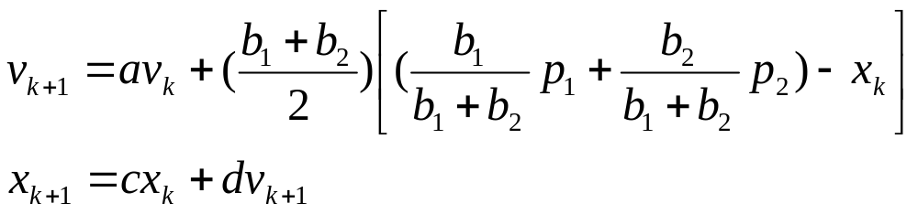
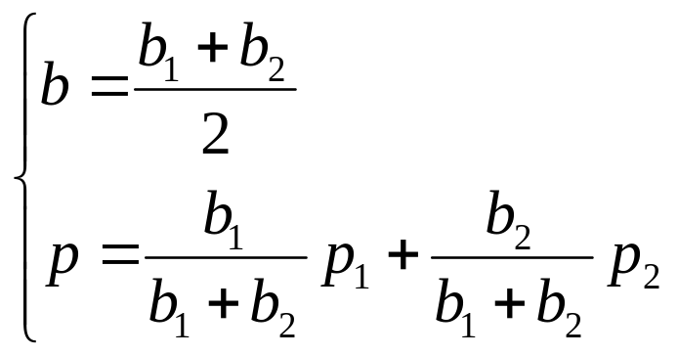
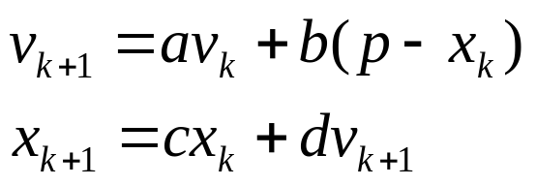
Deterministic algorithm (Cont.)
Notes:
b: attraction coefficient (the average of the “own” and “social” attraction coefficients b1 and b2)

Slide 13
Explain the parameters
The attraction coefficient b is the average of the “own” and “social” attraction coefficients b1 and b2.
The attraction point p is the weighted average of p1 and p2.

Slide 14
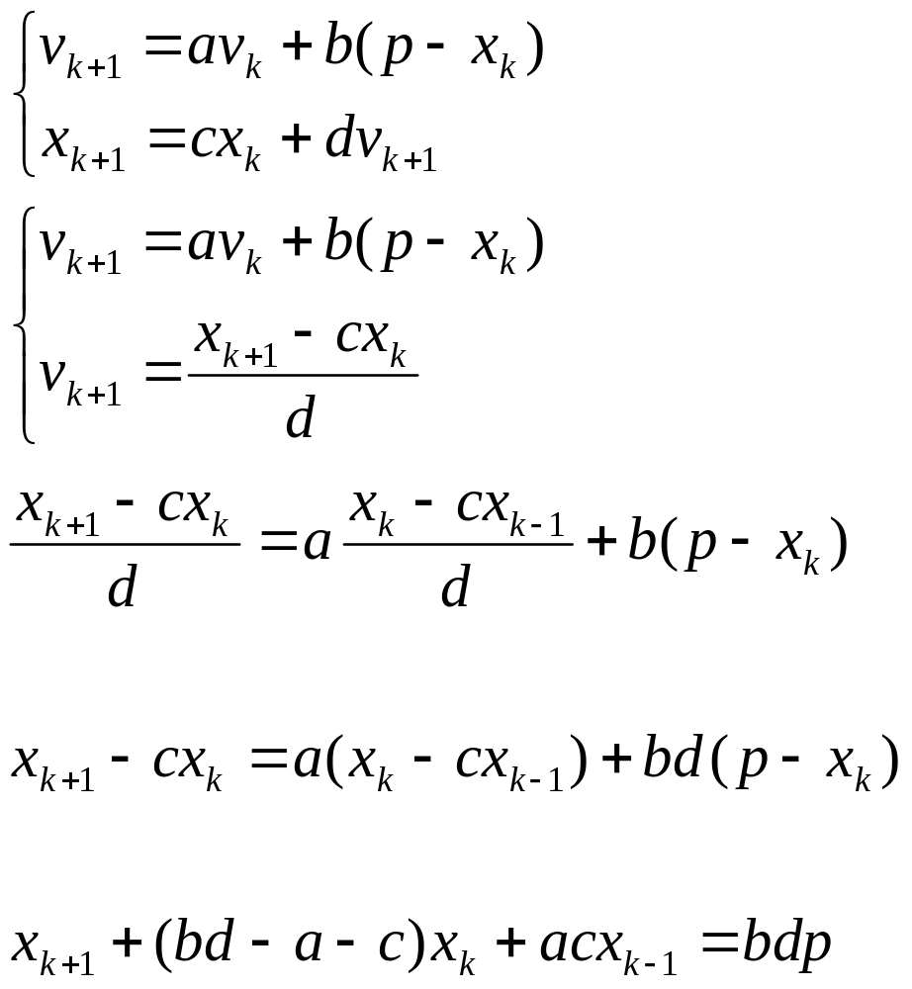
Yield the second order recursion

Slide 15
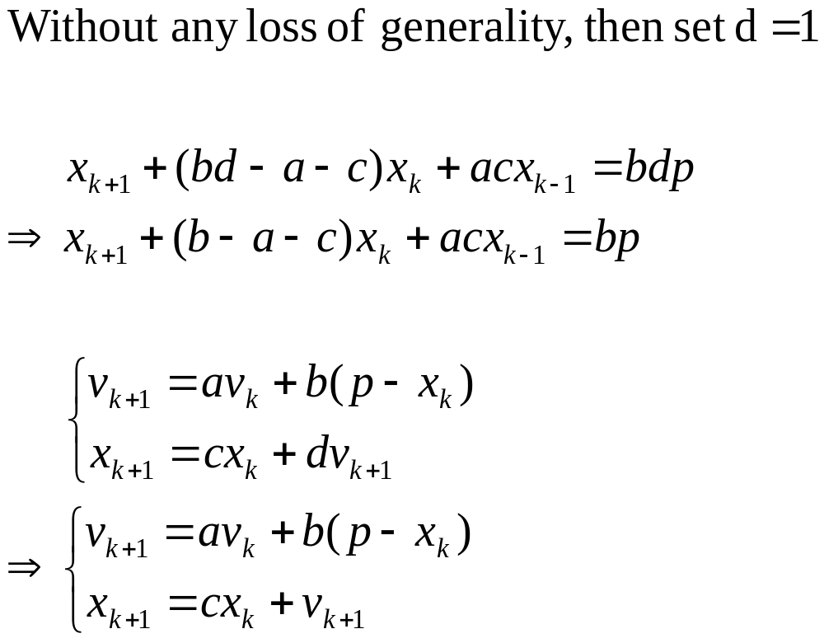
Algorithm with d = 1

Slide 16
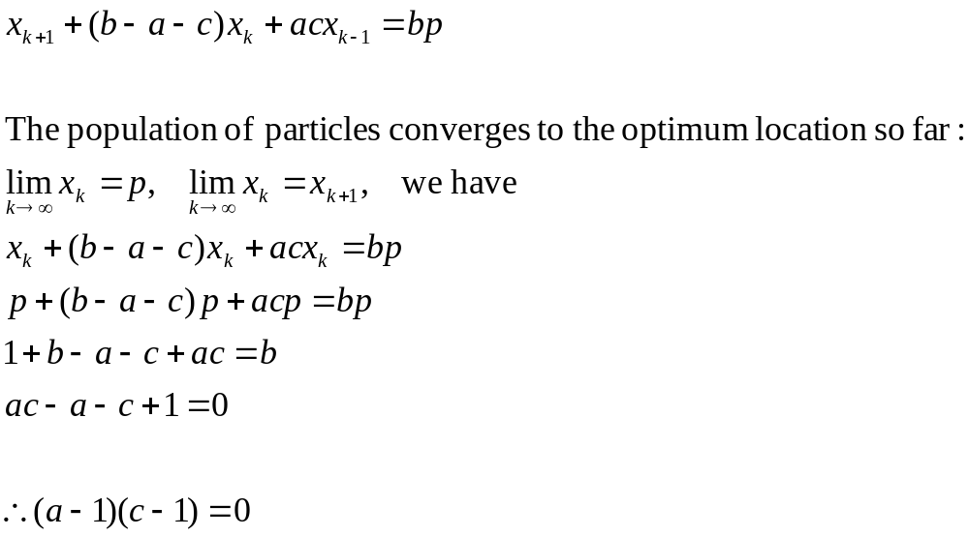
For optimization purposes

Slide 17
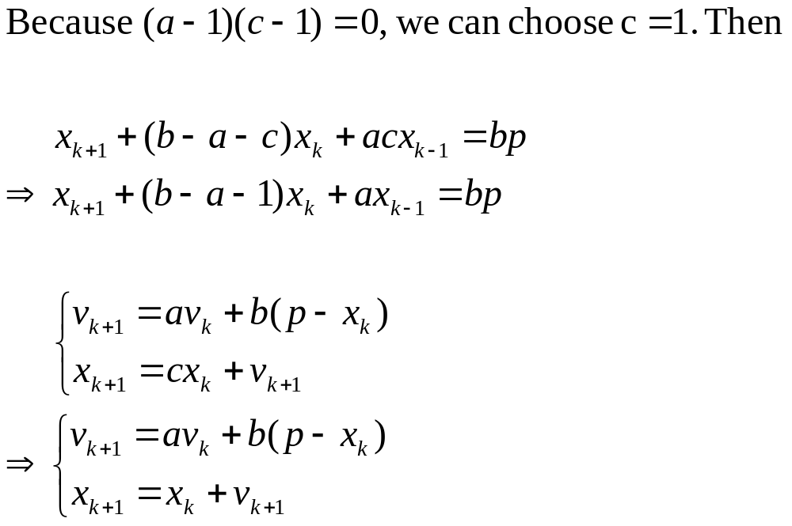
Algorithm with c = 1

Slide 18
Using dynamic analysis
a theory of linear, discrete-time dynamic systems
provides a powerful set of tools and results for assessing the dynamic behavior of a particle.

Slide 19
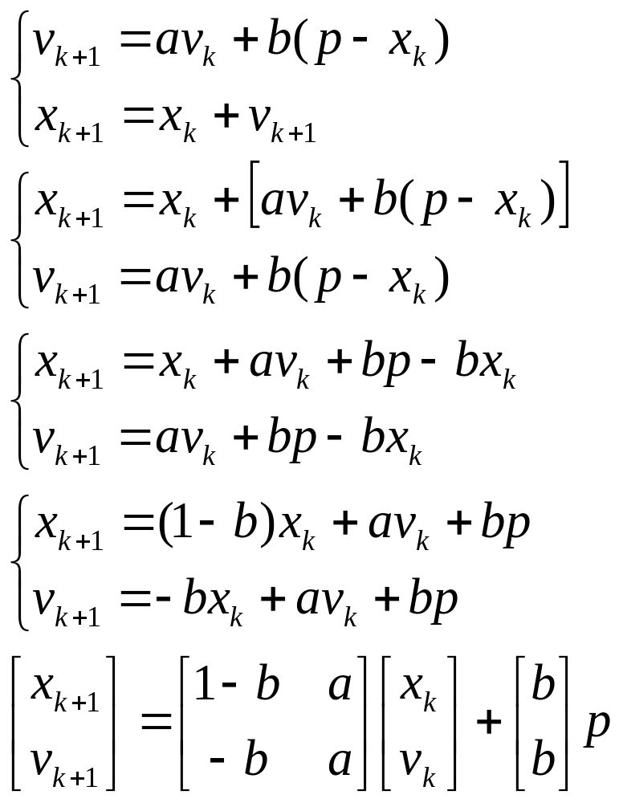
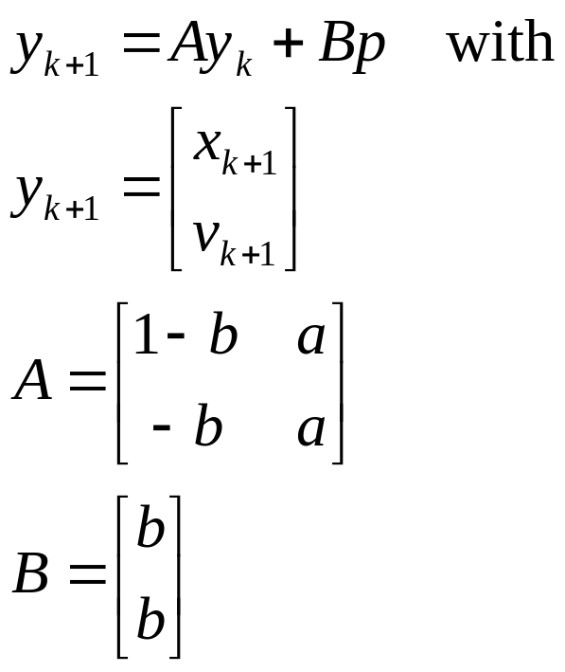
Matrix form

Slide 20
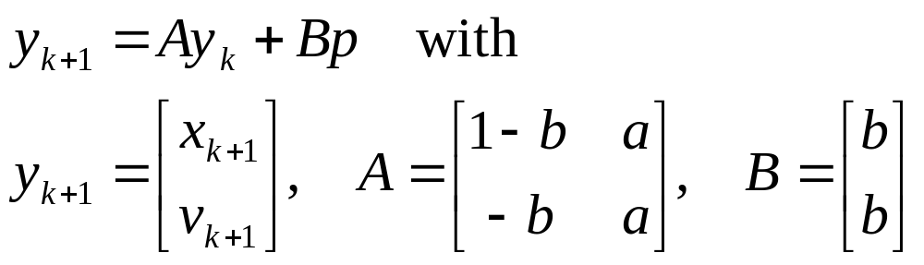
Explain variables for matrix
y_{k} :particle state
made up of its current position and velocity
A: the dynamic system
determine the time behavior of the particle
p: the external input
used to drive the particle towards a specified position
B: the input matrix
affect the external input

Slide 21
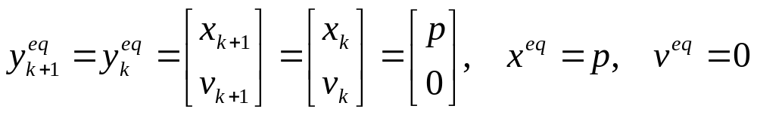
Equilibrium point (均衡點)
An equilibrium point is a state maintained by the dynamic system in absence of external excitation (i.e., p = constant)

Slide 22
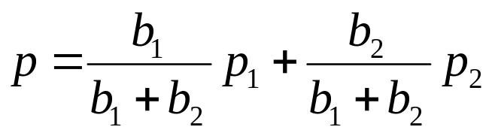
Equilibrium point (均衡點) (Cont.)
Equilibrium
point
convergence
At equilibrium (provided other particles do not find better position)
i.e., p2(global position) and p do not change.
The considered particle must have zero velocity and must be positioned at the attraction point p.

Slide 23
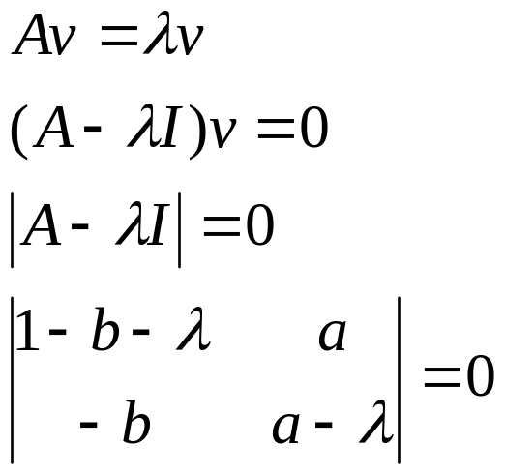
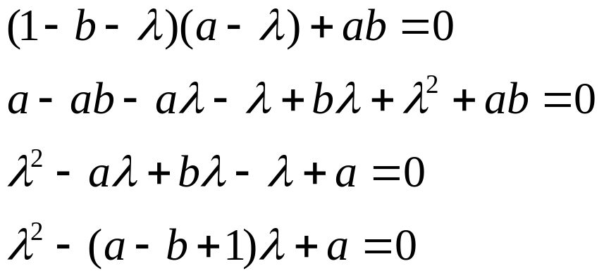
Standard result from dynamic system theory
The time behavior of the particle depends on the eigenvalues of the dynamic matrix A.
The eigenvalues λ₁, λ₂ (either real or complex)

Slide 24
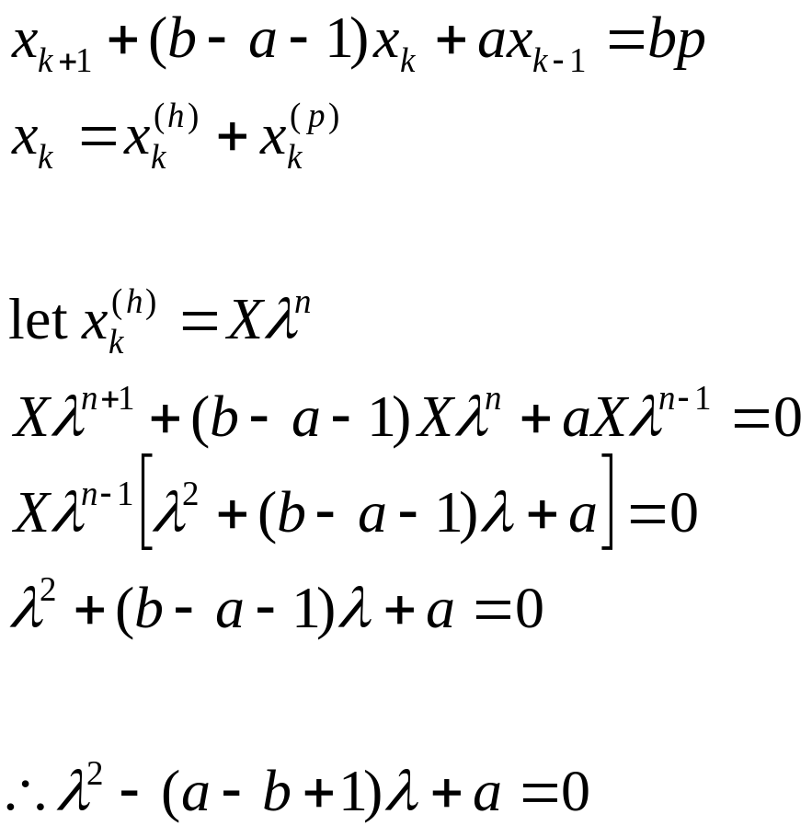
Characteristic equation

Slide 25
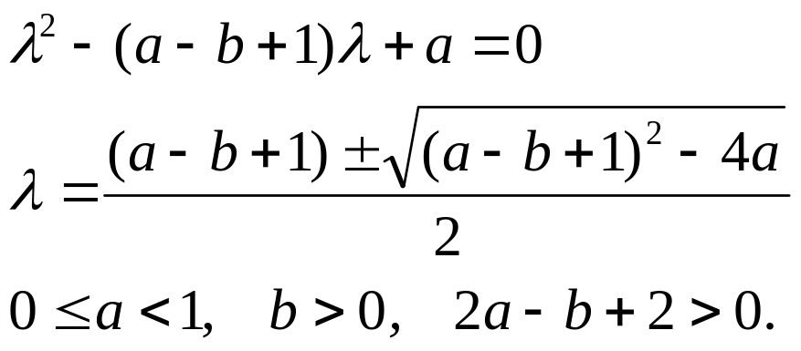
Characteristic root
The necessary and sufficient condition for the equilibrium point to be stable is that both eigenvalues of the matrix A (whether real or
complex) have magnitude less than1.
Why?

Slide 26
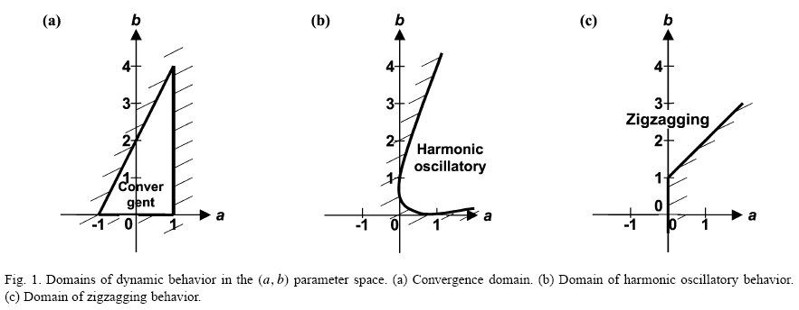

Slide 27
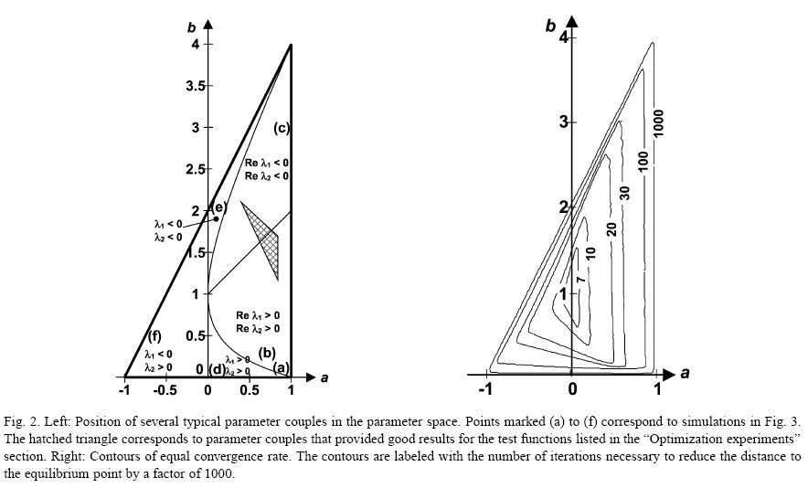

Slide 28
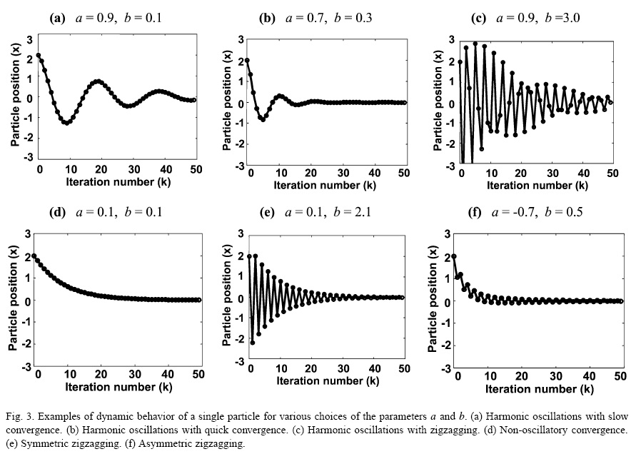

Slide 29
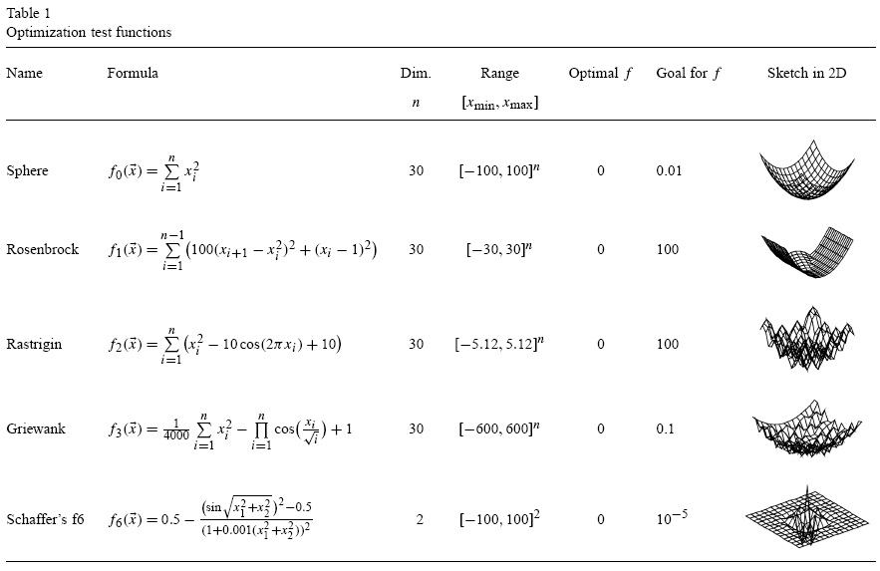
Optimization test function

Slide 30
